Slide 1
Multiplication Example
1011 Multiplicand (11 dec)
x 1101 Multiplier (13 dec)
1011 Partial products
0000 Note: if multiplier bit is 1 copy multiplicand (place value) otherwise zero
1011
1011
10001111 Product (143 dec)

Slide 2
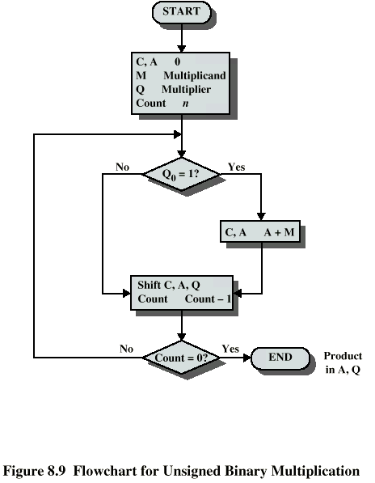
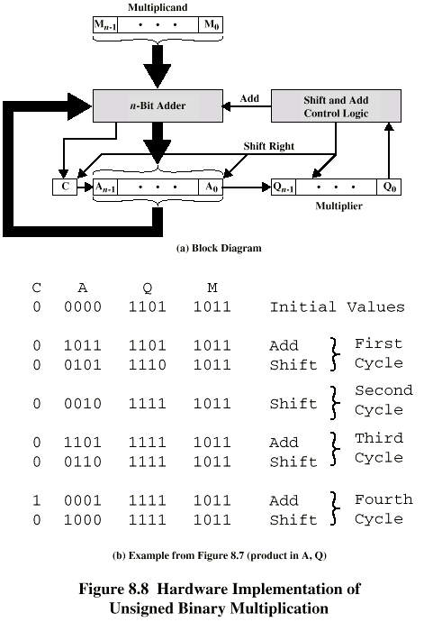
Unsigned Binary Multiplication

Slide 3
Execution with Example (11*13)

Slide 4
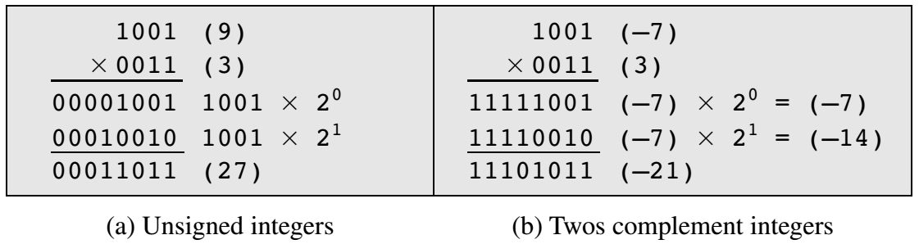
Multiplying Negative Numbers
This does not work! Eg. If we multiply 11 (1011) by 13 (1101) we should get 143 (10001111).
If we interpret these as two’s complement numbers, we have -5 (1011) times
-3(1101) which equals -113(10001111) which is incorrect.
It will also not work if either the multiplicand or the multiplier is negative.
If 9 and 3 are treated as unsigned integers, the multiplication proceeds simply fig a.
But if 1001 is interpreted as the
twos complement value -7, then
each partial product must be a
negative twos complement number of 2n(8) bits, as shown in Figure b.
Note: this is accomplished by padding out each partial product to the left with binary 1s
Notes:
<number>

Slide 5

If the multiplier is negative
If the multiplier is negative, straightforward multiplication also will not work.
The reason is that the bits of the multiplier no longer correspond to the shifts or multiplications that must take place.
For example, the 4-bit decimal number -3 is written 1101 in twos complement. If we simply took partial products based on each bit position, we have
instead of

Slide 6
Solutions to the above issues
Solution 1
Convert to positive if required
Multiply as above
If signs were different, negate answer
Solution 2
Booth’s algorithm

Slide 7
Booth’s multiplier coding
0 1 1 1 1
(0 0) 0
(1 1) 0
(1 0) -1
(0 1) +1
1 1 1 1 0

Slide 8
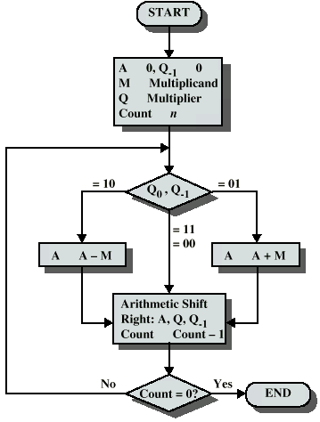
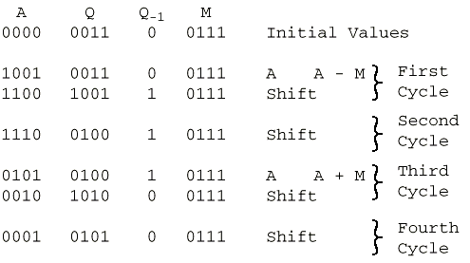
Booth’s Algorithm with example

Slide 9
Description of the algorithm
As before, the multiplier and multiplicand are placed in the Q and M registers, respectively.
There is also a 1-bit register placed logically to the right of the least significant bit of the Q register and designated its use is explained shortly.
The results of the multiplication will appear in the A and Q registers.
A and Q₋₁ are initialized to 0. As before, control logic scans the bits of the multiplier one at a time.
Now, as each bit is examined, the bit to its right is also examined.
If the two bits are the same (1–1 or 0–0), then all of the bits of the A, Q, and Q₋₁ registers are shifted to the right by 1 bit. If the two bits differ, then the multiplicand is added to or subtracted from the A register, depending on whether the two bits are 0–1 or 1–0.
Following the addition or subtraction, the right shift occurs. In either case, the right shift is such that the leftmost bit of A, namely A_{n-1}not only is shifted into A_{n-2} but also remains in A_{n-1}
This is required to preserve the sign of the number in A and Q. It is known as an arithmetic shift, because it preserves the sign bit.
Finally the result is at A and Q registers.

Slide 10
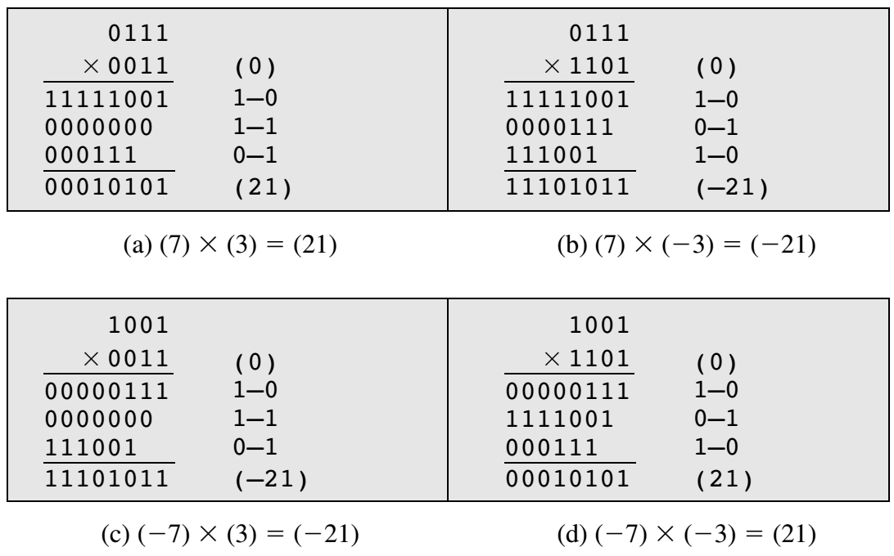
Some more examples
Note: For Q_{n} and Q_{n-1}
If 1-1/0-0 the value of A will not change ie. Will remain 0000 (1st case)
If 1-0, A=A-M= 0000-0111=1001
If 0-1, A=A+M= 0000+0111=0111
But for each positive intermediate value, 0s will be appended at left and for negative value, 1s will be appended at the left side.

